Slide 1
Sales Insights
Your Logo
Data-Driven Analysis and Strategy
MM/DD/20XX

Slide 2

Introduction
This presentation explores the use of Exploratory Data Analysis (EDA) to extract actionable sales insights. The analysis focuses on revealing patterns in sales data through rigorous data cleaning, preprocessing, and visualization. The goal is to support strategic decisions that foster business growth and enhance stakeholder understanding.

Slide 3
Project Overview and Methodology

Slide 4
Objectives and Deliverables
The project aims to deliver a thoroughly cleaned dataset, insightful analysis, and a concise summary presentation. These deliverables enable data-driven decision-making to optimize sales strategies and improve business outcomes.

Slide 5
Data Cleaning and Preprocessing
The analysis begins with rigorous data cleaning and preprocessing to ensure data quality. This phase involves removing inconsistencies and preparing the data for reliable visualization and interpretation using advanced Python libraries.

Slide 6

Analytical Tools and Approach
The project employs Pythons data analytics libraries for visualization and analysis. This systematic approach ensures accuracy and depth, promoting insights that reflect true sales dynamics and customer behavior.

Slide 7
Product Category Sales Analysis

Slide 8
Price Distribution and Median Pricing
Price analysis reveals a consistent median price of 50 across all product categories. This uniform pricing indicates a balanced strategy that may influence consumer buying patterns by maintaining competitive market positioning.

Slide 9
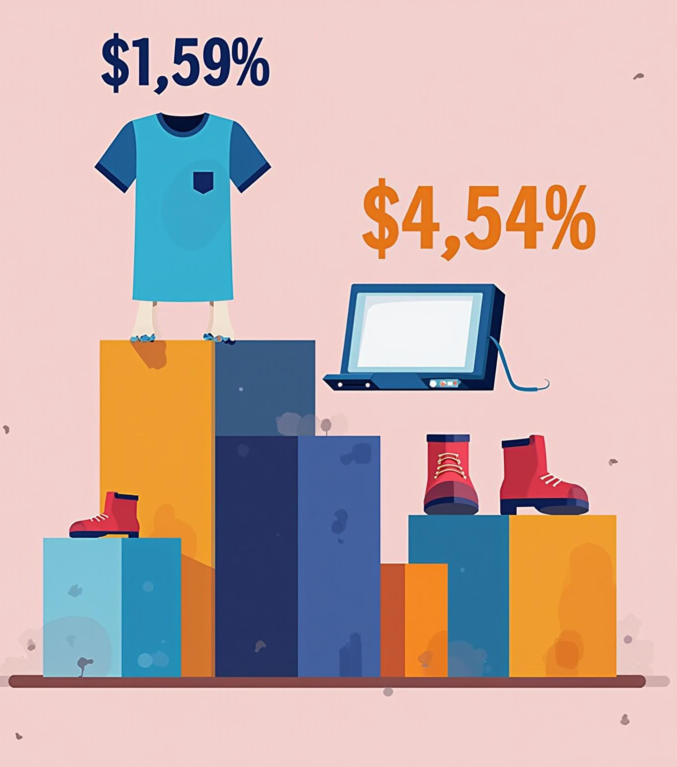
Transaction Volume by Category
Clothing leads in transaction volume with 351 sales, followed closely by Electronics at 342. These figures highlight consumer preferences that can inform inventory management and targeted marketing initiatives.

Slide 10
Revenue Contribution Comparison
Although Clothing recorded the highest transaction volume, Electronics outperforms it in total revenue, generating approximately $7,156,905 compared to Clothing’s $7,155,580. This indicates that Electronics sales, while fewer, have higher value, emphasizing the need to focus on both transaction counts and revenue contribution for balanced strategy development.

Slide 11
Customer Demographics and Behavior

Slide 12
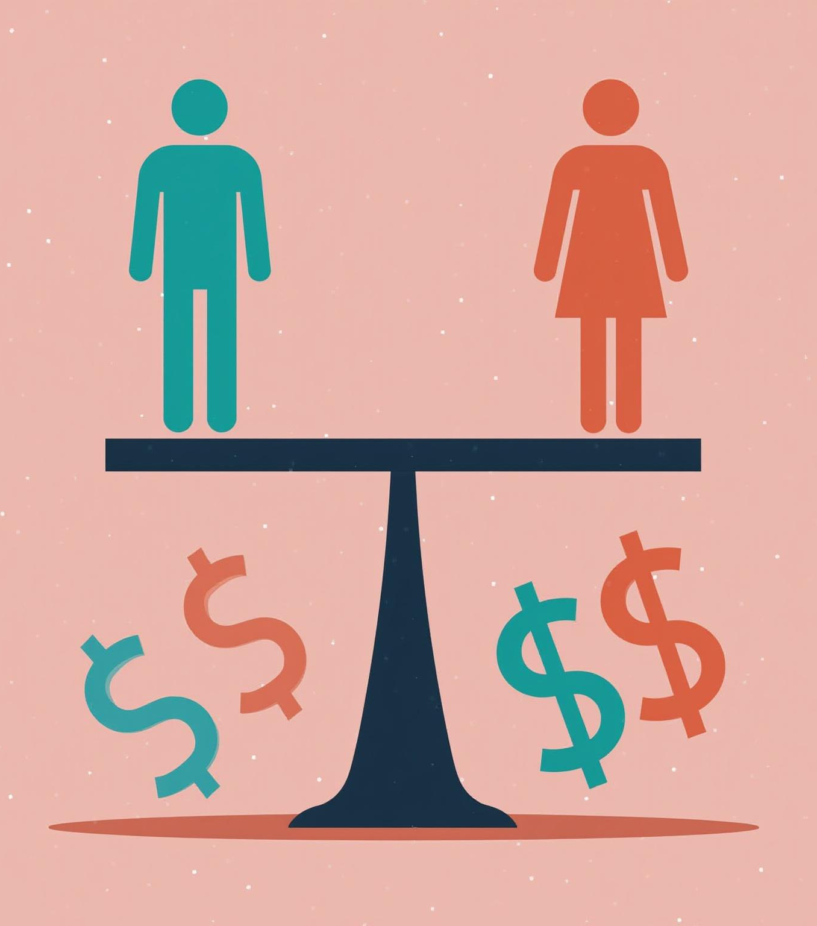
Gender-Based Revenue Contribution
Revenue generation is nearly balanced between genders, with females contributing slightly more at around $220,000, compared to males at $215,000. This close split supports the development of marketing strategies tailored to both genders, reinforcing balanced outreach and engagement efforts.

Slide 13
Age Group Revenue Insights
The age groups 25-34, 35-44, and 45-54 are the top revenue contributors, each generating close to $100,000. Targeted marketing and product offerings focused on these segments can optimize revenue generation, aligning with consumer spending behaviors in these key demographics.

Slide 14
Spending Preferences by Gender and Category
Both males and females show a distinct preference for Electronics and Clothing categories over Beauty. Understanding these preferences is vital for designing targeted promotions and campaigns that resonate well with consumer interests and maximize sales in favored categories.

Slide 15
Temporal and Segmented Sales Trends

Slide 16
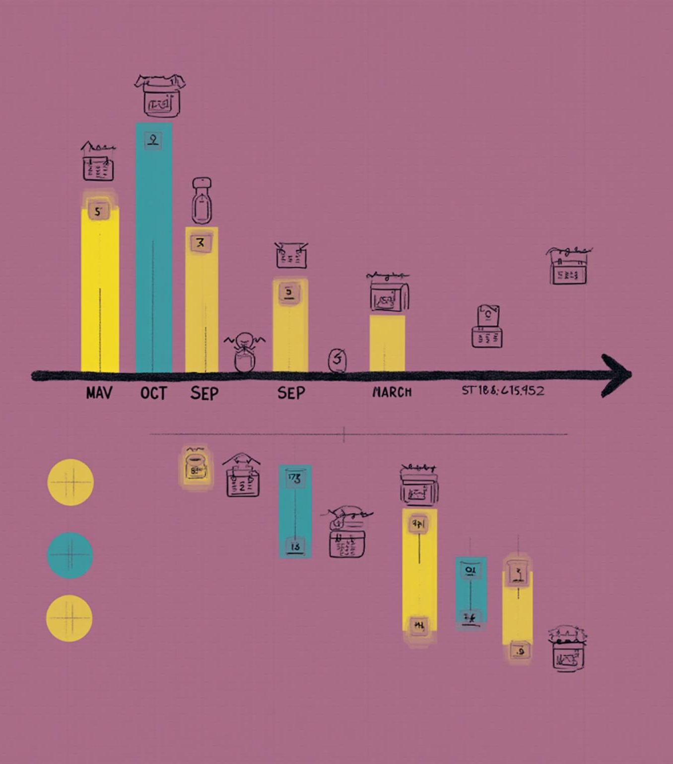
Monthly Revenue Fluctuations and Seasonality
Sales revenue exhibits notable peaks in May and October, suggesting seasonal influences or successful promotional campaigns during these months. Conversely, dips in March and September highlight periods needing targeted strategies to boost sales during traditionally lower-activity months.

Slide 17
Daily Spending Patterns
Average customer spending is highest on Saturdays, exceeding $7,500, and drops to the lowest on Wednesdays, around $7,410. This insight informs the scheduling of promotions and resource allocation to enhance revenue on high-spend days.

Slide 18
Age-Based Spending Behavior Analysis
Spending habits vary across age groups with a slight negative correlation observed. This suggests that younger or middle-aged segments may exhibit different spending behaviors, requiring nuanced segmentation strategies to capture distinct consumer needs effectively.

Slide 19
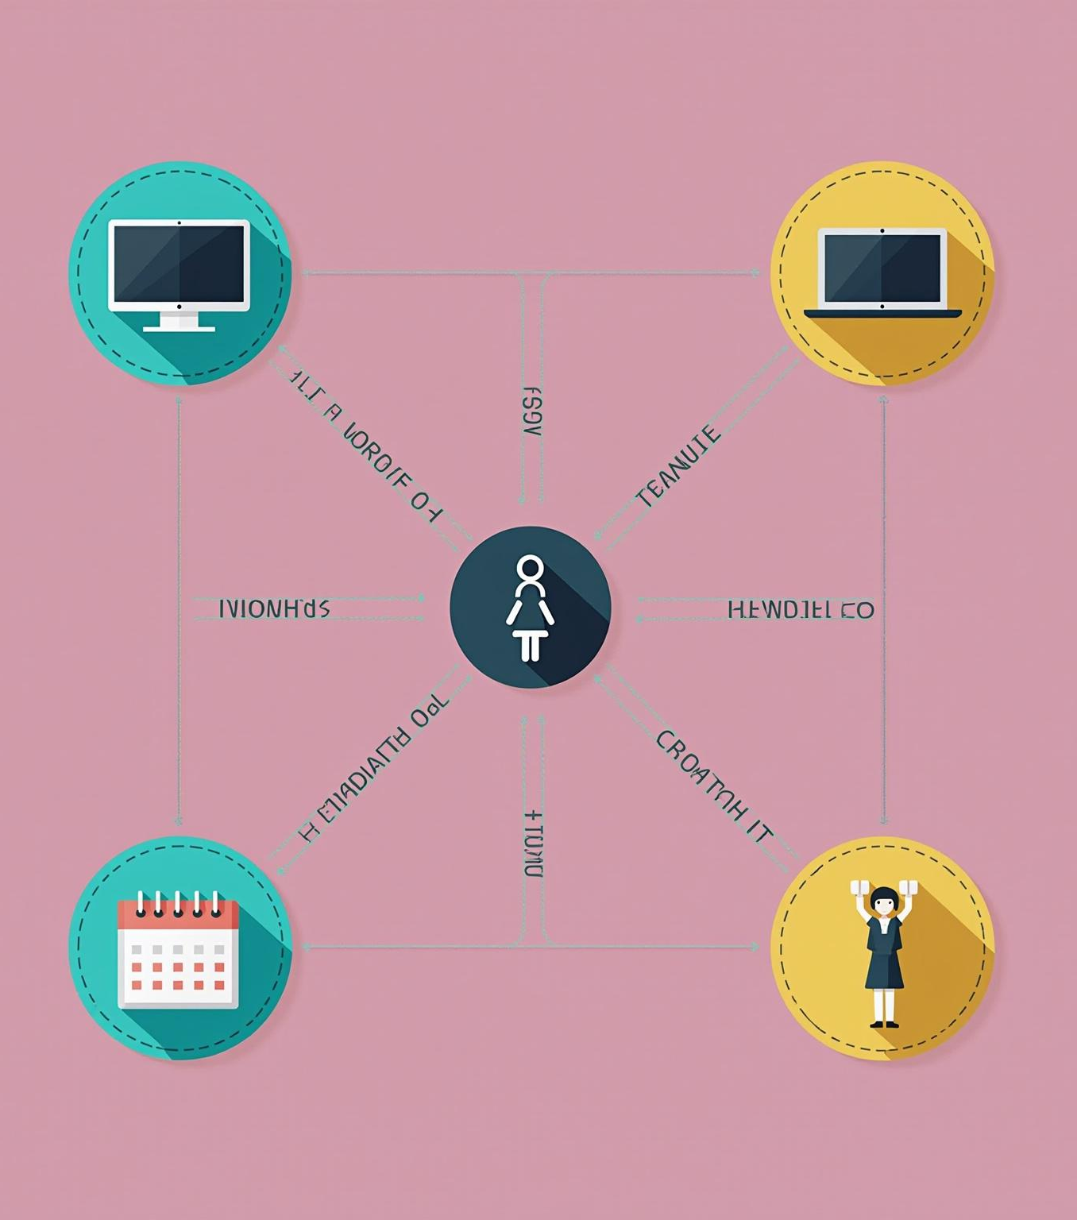
Conclusions
The analysis reveals key insights into category performance, customer demographics, and sales patterns. Emphasizing Electronics revenue potential, balanced gender marketing, and targeted age group campaigns can drive business growth. Additionally, recognizing temporal sales trends offers opportunities for optimizing promotions and resource allocation to maximize overall revenue.

Slide 20
Strategic Recommendations
Based on the analysis, prioritize investment in high-revenue categories like Electronics while maintaining balanced pricing strategies. Tailor marketing efforts to key demographics, especially ages 25-54 and both genders equally. Leverage seasonal trends by planning promotions during peak months and optimizing campaigns on high-spending days to maximize overall revenue growth.

Slide 24
Thank you
Do you have any questions?
youremail@freepik.com
+00 000 000 000
yourwebsite.com
Please keep this slide for attribution

